Slide 1

Bank Data Analysis by S. Alp Katar
1002210003

Slide 2
Bilgi
Düzenlenen bu kampanya kredi kartı müşterilerine yönelik.
Bu kampanyada Maximum kredi kartları ile yapılan market ve akaryakıt harcamalarında ayda 200 TL’ye kadar %5 Maxipuan verilecek.
Kampanyada hedef kitle, Bankamız kartları ile yeterli market ve akaryakıt harcaması yapmayan ama diğer harcama türlerini yapan müşteriler.
Kampanyanın iletişiminde SMS kullanılacak.

Slide 3
İstenen
Senden istenen, aşağıda verilen ‘Müşteri Listesi.xlsx’ dosyasını kullanarak bu kampanyaya uygun olan ve kampanya bildirimi yapılacak müşterilerin listesini çıkartman.
Bu dosyada 2 sayfa mevcut.
1) Müşteri bilgileri sayfasında 3.000 müşteriye ait temel bilgiler ile birlikte ev/araba sahipliği durumu, İşCep sahiplik durumu, SMS ve E-posta ile iletişim izni verip vermediği bilgileri var.
2) Harcama bilgileri sayfasında bu müşterilerin kredi kartları ile yaptığı Haziran, Temmuz ve Ağustos aylarındaki harcama türleri ve tutarları yer alıyor.

Slide 4
Beklenen çıktı
Yukarıda belirtildiği gibi herkese kampanyayı bildirmek ile hiç bildirmemek iki uçtaki seçenek. Temel amaç, bu ikisinin arasında ideal bir noktaya ulaşmak. Bu yüzden de tek bir doğru yanıt yok. Hedefin, harcama desenlerini, müşteri profillerini ve yasal regülasyonları bir arada düşünerek optimum olduğunu düşündüğün bir müşteri listesi hazırlamak.

Slide 5
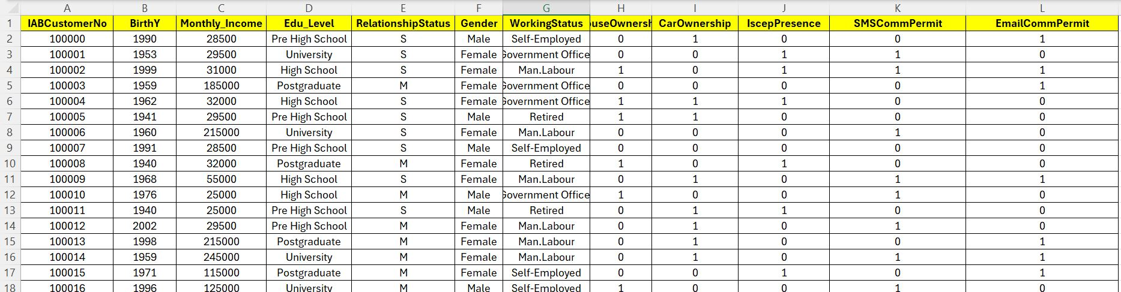
Customer Info

Slide 6
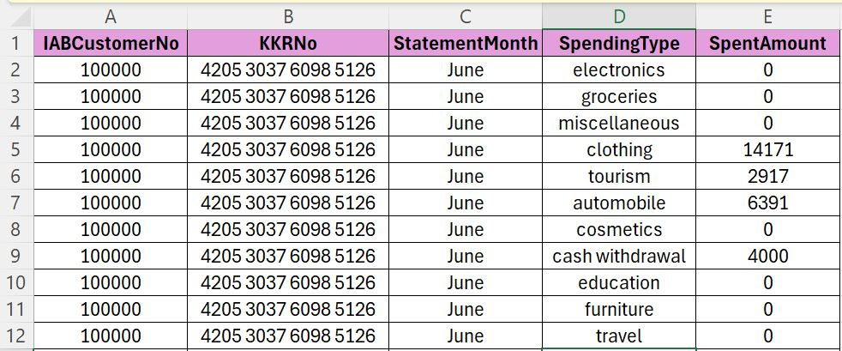
Spending Info

Slide 7
STEP 1: IMPORT AND LOAD THE DATA
import pandas as pd
import matplotlib.pyplot as plt
import seaborn as sns
# Optional: set style
sns.set(style="whitegrid")
# Load the datasets
customer_df = pd.read_excel("Customer_Info_2025.xlsx")
spending_df = pd.read_excel("Spending_Info_2025.xlsx")

Slide 8
STEP 2: PREPROCESSING
# Clean column names
spending_df['SpendingType'] = spending_df['SpendingType'].str.strip().str.lower()
customer_df.columns = [col.strip() for col in customer_df.columns]
# View unique categories (optional check)
print(spending_df['SpendingType'].unique())

Slide 9
Spending Type: ['electronics' 'groceries' 'miscellaneous' 'clothing' 'tourism' 'automobile' 'cosmetics' 'cash withdrawal' 'education' 'furniture' 'travel' 'white appliances' 'gasoline' 'tax spendings']

Slide 10
STEP 3: AGGREGATE SPENDING & MERGE WITH CUSTOMER DATA
# Pivot the data to get total spent by category per customer
agg_spending = spending_df.groupby(['IABCustomerNo', 'SpendingType'])['SpentAmount'].sum().unstack(fill_value=0)
agg_spending.reset_index(inplace=True)
# Merge with customer info
merged_df = pd.merge(customer_df, agg_spending, on='IABCustomerNo', how='left')
merged_df.fillna(0, inplace=True) # fill NA values with 0s

Slide 11
STEP 4: ELIGIBLE CUSTOMERS FOR CAMPAIGN
# Spending column names
spending_cols = agg_spending.columns.drop('IABCustomerNo')
other_categories = [col for col in spending_cols if col not in ['groceries', 'gasoline']]
# Compute aggregated features
merged_df['OtherSpending'] = merged_df[other_categories].sum(axis=1)
merged_df['GroceriesAndFuel'] = merged_df['groceries'] + merged_df['gasoline']

Slide 12
# Eligibility criteria:
merged_df['Eligible'] = (
(merged_df['OtherSpending'] >= 1000) &
(merged_df['GroceriesAndFuel'] < 500) &
(merged_df['SMSCommPermit'] == 1)
)
# Filter eligible customers
eligible_customers = merged_df[merged_df['Eligible']]

Slide 13
GRAPH #1: TOTAL SPENDING PER CATEGORY
total_by_category = spending_df.groupby('SpendingType')['SpentAmount'].sum().sort_values(ascending=False)
plt.figure(figsize=(10, 6))
sns.barplot(x=total_by_category.values, y=total_by_category.index)
plt.title('Total Spending by Category (All Customers)')
plt.xlabel('Total Amount (TL)')
plt.tight_layout()
plt.show()

Slide 14
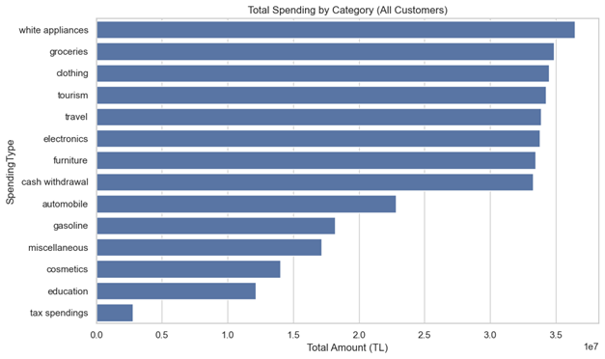

Slide 15
GRAPH #2: HISTOGRAM OF GROCERIES + GASOLINE SPENDING
plt.figure(figsize=(8, 6))
sns.histplot(merged_df['GroceriesAndFuel'], bins=30, kde=True)
plt.title('Distribution of Groceries + Gasoline Spending')
plt.xlabel('Amount Spent (TL)')
plt.tight_layout()
plt.show()

Slide 16
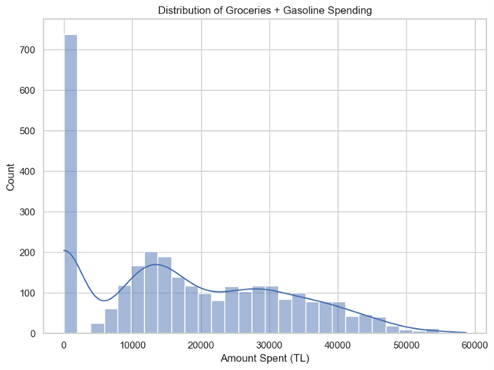

Slide 17
GRAPH #3: AGE DISTRIBUTION (CORRECTED)
# Ensure BirthY is numeric and not missing
merged_df = merged_df[merged_df['BirthY'].notnull()]
merged_df['BirthY'] = pd.to_numeric(merged_df['BirthY'], errors='coerce')
# Recalculate age
merged_df['Age'] = 2025 - merged_df['BirthY']
eligible_customers = merged_df[merged_df['Eligible']] # refresh eligible customers
# Plot the age distribution
plt.figure(figsize=(8, 6))
sns.histplot(eligible_customers['Age'], bins=20, kde=True)
plt.title('Age Distribution of Eligible Customers')
plt.xlabel('Age')
plt.tight_layout()
plt.show()

Slide 18
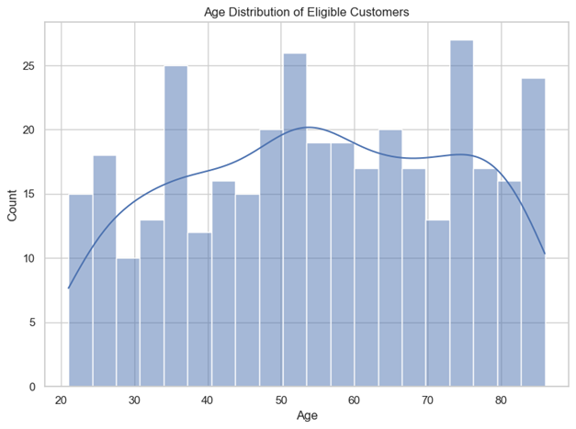

Slide 19
GRAPH #4: EDUCATION LEVEL VS ISCEP APP USAGE
edu_app_summary = eligible_customers.groupby(['Edu_Level', 'IscepPresence']).size().unstack(fill_value=0)
plt.figure(figsize=(10, 6))
edu_app_summary.plot(kind='bar', stacked=True)
plt.title('Education Level vs İşCep App Usage (Eligible Customers)')
plt.ylabel('Customer Count')
plt.tight_layout()
plt.show()

Slide 20
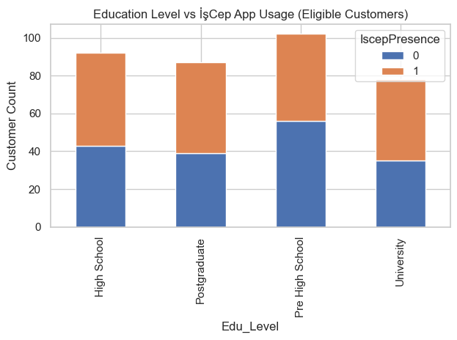

Slide 21
GRAPH #5: COMMUNICATION CHANNEL PERMISSIONS
comm_perm_summary = merged_df.groupby('Eligible')[['SMSCommPermit', 'EmailCommPermit']].mean() * 100
plt.figure(figsize=(8, 5))
comm_perm_summary.T.plot(kind='bar', figsize=(8, 5))
plt.title('Communication Permission Rate (%) — Eligible vs. Others')
plt.ylabel('Permission Rate (%)')
plt.xticks(rotation=0)
plt.tight_layout()
plt.show()

Slide 22
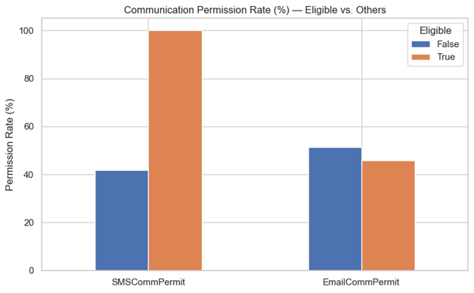

Slide 23
GRAPH #6: EDUCATION DISTRIBUTION BAR CHART
edu_counts = merged_df['Edu_Level'].value_counts()
plt.figure(figsize=(8, 6))
sns.barplot(x=edu_counts.index, y=edu_counts.values)
plt.title('Customer Count by Education Level')
plt.ylabel('Number of Customers')
plt.xticks(rotation=45)
plt.tight_layout()
plt.show()

Slide 24
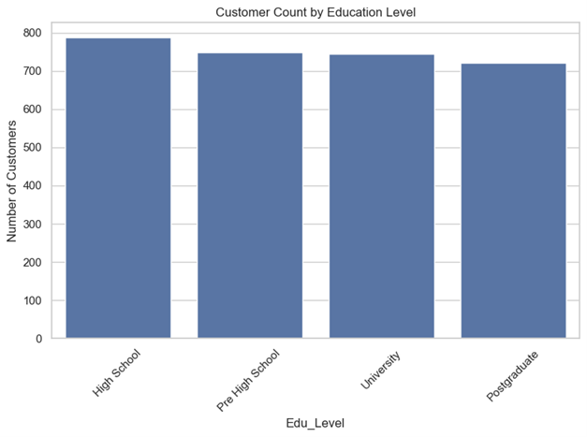

Slide 25
GRAPH #7: RELATIONSHIP STATUS PIE CHART
rel_counts = merged_df['RelationshipStatus'].value_counts()
plt.figure(figsize=(6, 6))
plt.pie(rel_counts, labels=rel_counts.index, autopct='%1.1f%%', startangle=90)
plt.title('Relationship Status Distribution')
plt.axis('equal') # Equal aspect ratio ensures pie is circular
plt.tight_layout()
plt.show()

Slide 26
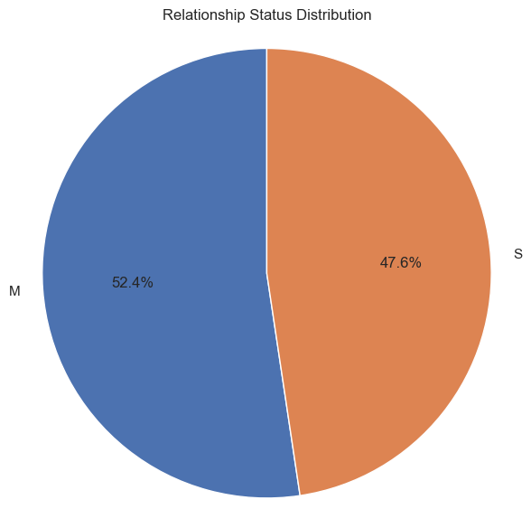

Slide 27
GRAPH #8: HOUSE OWNERSHIP PIE CHART
house_own_counts = merged_df['HouseOwnership'].value_counts()
labels = ['No House', 'Owns House']
plt.figure(figsize=(6, 6))
plt.pie(house_own_counts, labels=labels, autopct='%1.1f%%', startangle=90)
plt.title('House Ownership Distribution')
plt.axis('equal')
plt.tight_layout()
plt.show()

Slide 28
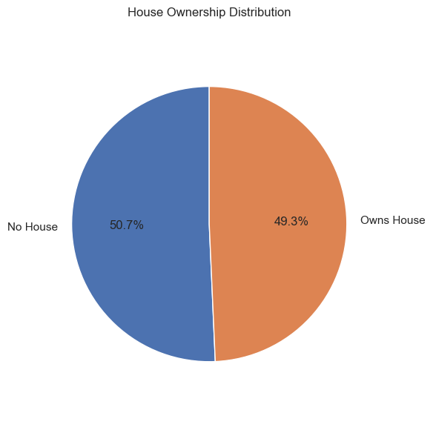

Slide 29
GRAPH #9: NORMALIZED VIEW SCATTER GRAPH
# Min-max normalization
def normalize(series):
return (series - series.min()) / (series.max() - series.min())
merged_df['norm_groceryfuel'] = normalize(merged_df['grocery_fuel_total'])
merged_df['norm_other'] = normalize(merged_df['other_total'])
plt.figure(figsize=(10, 6))
colors = merged_df['target_flag'].map({0: 'gray', 1: 'crimson’})
plt.scatter(
merged_df['norm_groceryfuel'],
merged_df['norm_other'],

Slide 30
c=colors,
alpha=0.6,
edgecolors='k',
linewidths=0.3,
s=20
)
plt.title("Normalized View: Target vs Other Customers", fontsize=14)
plt.xlabel("Normalized Groceries + Gasoline Spending", fontsize=12)
plt.ylabel("Normalized Other Category Spending", fontsize=12)
plt.grid(True, linestyle='--', alpha=0.7)
plt.tight_layout()
plt.legend(handles=legend_elements, loc='upper right')
plt.show()

Slide 31
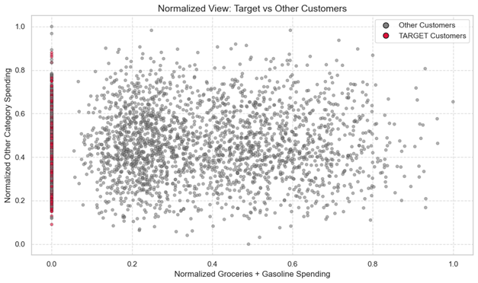

Slide 32
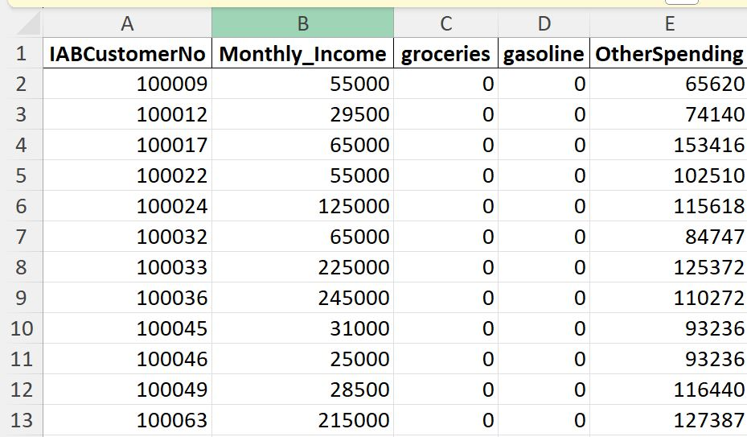
STEP 5: EXPORT FINAL ELIGIBLE CUSTOMER LIST
eligible_customers[['IABCustomerNo', 'Monthly_Income', 'groceries', 'gasoline', 'OtherSpending']].to_excel("Eligible_Customers_For_Campaign.xlsx", index=False)
Eligible_Customers_For_Campaign.xlsx

Slide 33
Results and Suggestions
The prepared Eligible_Customers_For_Campaign.xlsx file contains 359 customers who precisely match the core objectives of the campaign.
These customers:
-Spent ₺0 on groceries and gasoline in the last three months, well below thresholds like ₺2,500 or ₺5,000 per month.
-Displayed high levels of engagement in other spending categories, with:
Average spending in other categories: ₺101,875
Minimum other spending: ₺20,136
Maximum other spending: ₺195,811
This pattern clearly demonstrates that these individuals have an active financial relationship with the bank, but they underutilize their cards for the campaign-targeted spending categories (groceries and gasoline).

Slide 34
Recommendation:
Given their high overall activity and verified SMS communication permission, these customers represent a high-impact opportunity for targeted outreach. We recommend segmenting them into two actionable groups:
--Strategic Target
₺0 groceries/fuel spending
₺100K+ in other categories
Highest potential for conversion
--Growth Potential
Other-heavy spenders close to strategic profile
Can be activated with timely messaging

Slide 35
SMS Sending Recommendation – Marketing & Analytics Team
Dear Sir/Madam,
As part of our ongoing "5% Maxipoints on Grocery and Fuel Purchases" campaign, we have completed a data-driven analysis tailored to identify the most relevant target audience.
The prepared file, Eligible_Customers_For_Campaign.xlsx, includes customers who:
Have been actively using their credit cards in various categories over the past three months,
Yet have made no purchases in the grocery or fuel categories (₺0),
While their average spending in other categories exceeds ₺100,000, indicating strong engagement with the bank.
This clearly shows that these customers maintain an active financial relationship, but have not yet utilized their cards for the categories targeted by this campaign.

Slide 36
SMS Sending Recommendation – Customer Segments
Strategic Target:
Customers with zero spending in groceries and fuel, but very high transaction volumes in other categories.
→ These are the highest conversion potential customers.
Growth Potential:
Customers whose spending patterns are close to the strategic group, and can be influenced through well-timed, personalized messaging.
→ Represents a secondary but highly valuable segment.

Slide 37
CAMPAIGN OPPORTUNITY!
🛒 5% Maxipoints on Grocery & Fuel Spending
We’re Activating Our Strategic Customers!
Our Target Audience is Ready.
Based on data-driven analysis, the Eligible_Customers_For_Campaign.xlsx list includes:
✔️ Customers who actively used their credit card over the last 3 months
✔️ Yet spent very little (₺0) on grocery and fuel categories
✔️ All of whom have granted SMS communication permission

Slide 38
CAMPAIGN OPPORTUNITY!
Customer Segments:
Strategic Target: Customers with very low grocery + fuel spending but very high volume in other categories
→ This is our highest potential group for conversion
Growth Potential: Customers whose behavior is close to the strategic profile and are ready to be activated with the right messaging

Slide 39
CAMPAIGN OPPORTUNITY!
Why Should We Send SMS to These Customers?
They’ve opted in for SMS communication
They’re highly active, engaged, and loyal
A targeted campaign has strong potential for high ROI
Opportunity to grow total credit card volume significantly
Send Now — Drive Campaign Performance
Campaign success starts by reaching the right customer at the right moment. Let’s turn this insight into action.

Slide 40
CAMPAIGN OPPORTUNITY!
[Institution Name] Marketing & Data Analytics Team
Campaign Period: [Insert Date Range]
File: Eligible_Customers_For_Campaign.xlsx

Slide 41
